Slide 1

An Assessment of the Effects of Microfinance & Remittances on Poverty in Developing Countries
Pablo A. Garcia Fuentes, DCOBA; Letreanna Jackson, Gordon T. & Ellen West College of Education; Yaman Joshi, MBA Business Analytics

Slide 2
Introduction
Remittances have emerged as a significant form of external funding for developing nations.
Workers sent remittances to low- and middle-income nations, starting from $17.7 billion in 1980 and increasing to $29.4 billion in 1990, $74.1 billion in 2000, and $300.5 billion in 2010. This amount grew to $503.5 billion by 2020 and reached $592.3 billion by 2022. (Source: Data World Development Indicators)
Remittances have become the second-largest source of funds for low- and middle-income countries, surpassing net official development assistance (NODA) and portfolio equity flows and trailing only behind foreign direct investment (FDI).

Slide 3
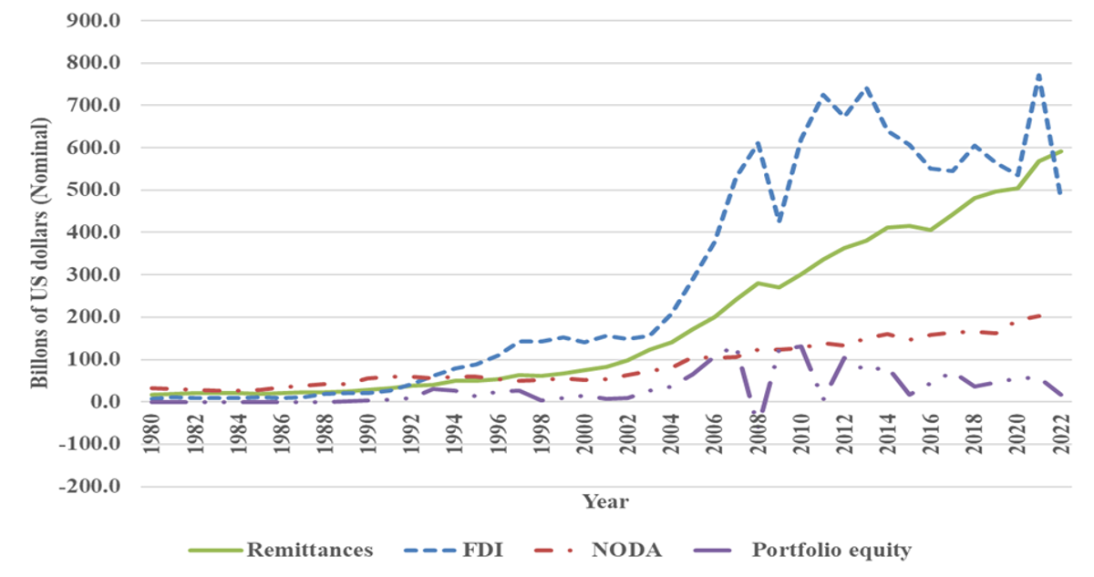
Introduction
Source: Authors' calculations using data from the World Development Indicators.
FDI: Foreign Direct Investment, NODA: Net Official Development Assistance and
Official Aid Received.

Slide 4
Objectives
To assess the effects of microfinance and remittances on poverty in developing countries.
To conduct estimations of the effects of remittances on poverty based on the model in Adams and Page (2005), Boussetta (2021), Imai et al. (2012), and Posso (2015).
To identify if microfinance is a channel through which remittances can reduce poverty in developing nations.

Slide 5
Data
Data Source: World Bank’s World Development Indicator
Sample: The data cover 97 developing countries.
Developing regions:
Latin America and the Caribbean
Middle East and North Africa
Europe and Central Asia
East Asia
South Asia
Sub-Saharan Africa
Period: 1990 to 2020

Slide 6
Variables
Remittances : the sum of personal transfers and compensation of employees. (The World Bank)
Dependent Variable: Poverty – headcount at $2.15 a day.
Poverty gap – at $2.15 a day
Gross Loan portfolio – sum of all outstanding finance for all outstanding loans of clients.

Slide 7
Literature Review
Microfinance significantly reduces poverty in developing countries, especially when remittances are not considered in the analysis (Boussetta, 2022).
When remittances are included in the analysis, their impact on poverty reduction outweighs that of microfinance, indicating that remittances play a more significant role in poverty alleviation compared to microfinance initiatives alone (Boussetta, 2022).
A 10% increase in the share of international migrants leads to a 2.1% reduction in the proportion of people living on less than $1.00 per person per day, while a 10% increase in per capita official international remittances results in a 3.5% decrease in the share of individuals living in poverty (Adams Jr. & Page, 2005).

Slide 8
Literature Review
A combination of microfinance services and remittance inflows can have a synergistic effect on poverty reduction (Posso, 2015).
Instrument for Remittances: Variables that are related to the migrants’ home country, variables that proxy for the cost of remittances, and variables that are related to the migrants’ host country (Imai, K. S., Gaiha, R., Thapa, G., & Annim, S. K.,2012)

Slide 9

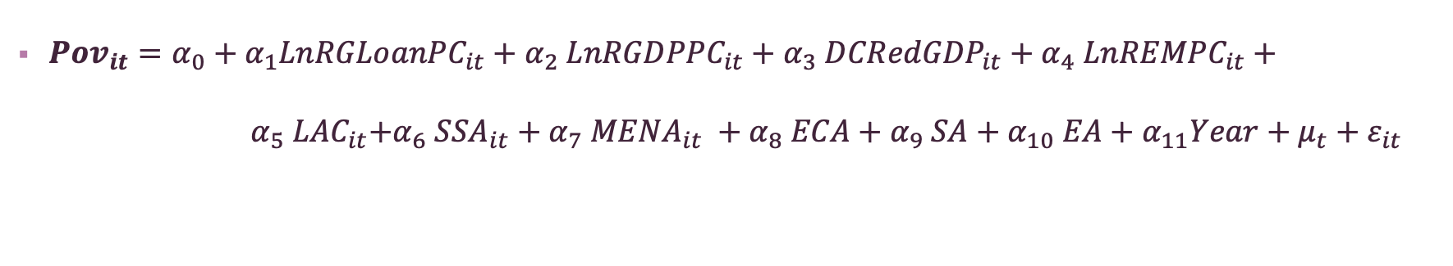
Methodology: Econometric Model
${Pov}_{it}=α_{0}+α_{1}{LnRGLoanPC}_{it}+α_{2} {LnRGDPPC}_{it}+α_{3} {DCRedGDP}_{it}+α_{4} {LnREMPC}_{it}+{ α}_{5}{ LAC}_{it}+α_{6} {SSA}_{it}+α_{7} {MENA}_{it} +α_{8} ECA+α_{9} SA+α_{10} EA+α_{11}Year+μ_{t}+ε_{it}$
${Pov}_{it}$​ represents the dependent variable.
$α_{0},α_{1}$ to $α_{10}$are the coefficients for the independent variables.
$μ_{t}$represents the time effects.
$ε_{it}$represents the error term.
LAC: Latin America and the Caribbean
MENA: Middle East and North Africa
ECA: Europe and Central Asia
SA: South Asia
EA: East Asia
SSA: Sub-Saharan Africa
RGLoanPC: Ln of Loans per Capita
RGDPPC: Ln of GDP per Capita
DCRedGDP: Change in GDP
REMP: Ln of Remittances per Capita
Ln : natural logarithm

Slide 10
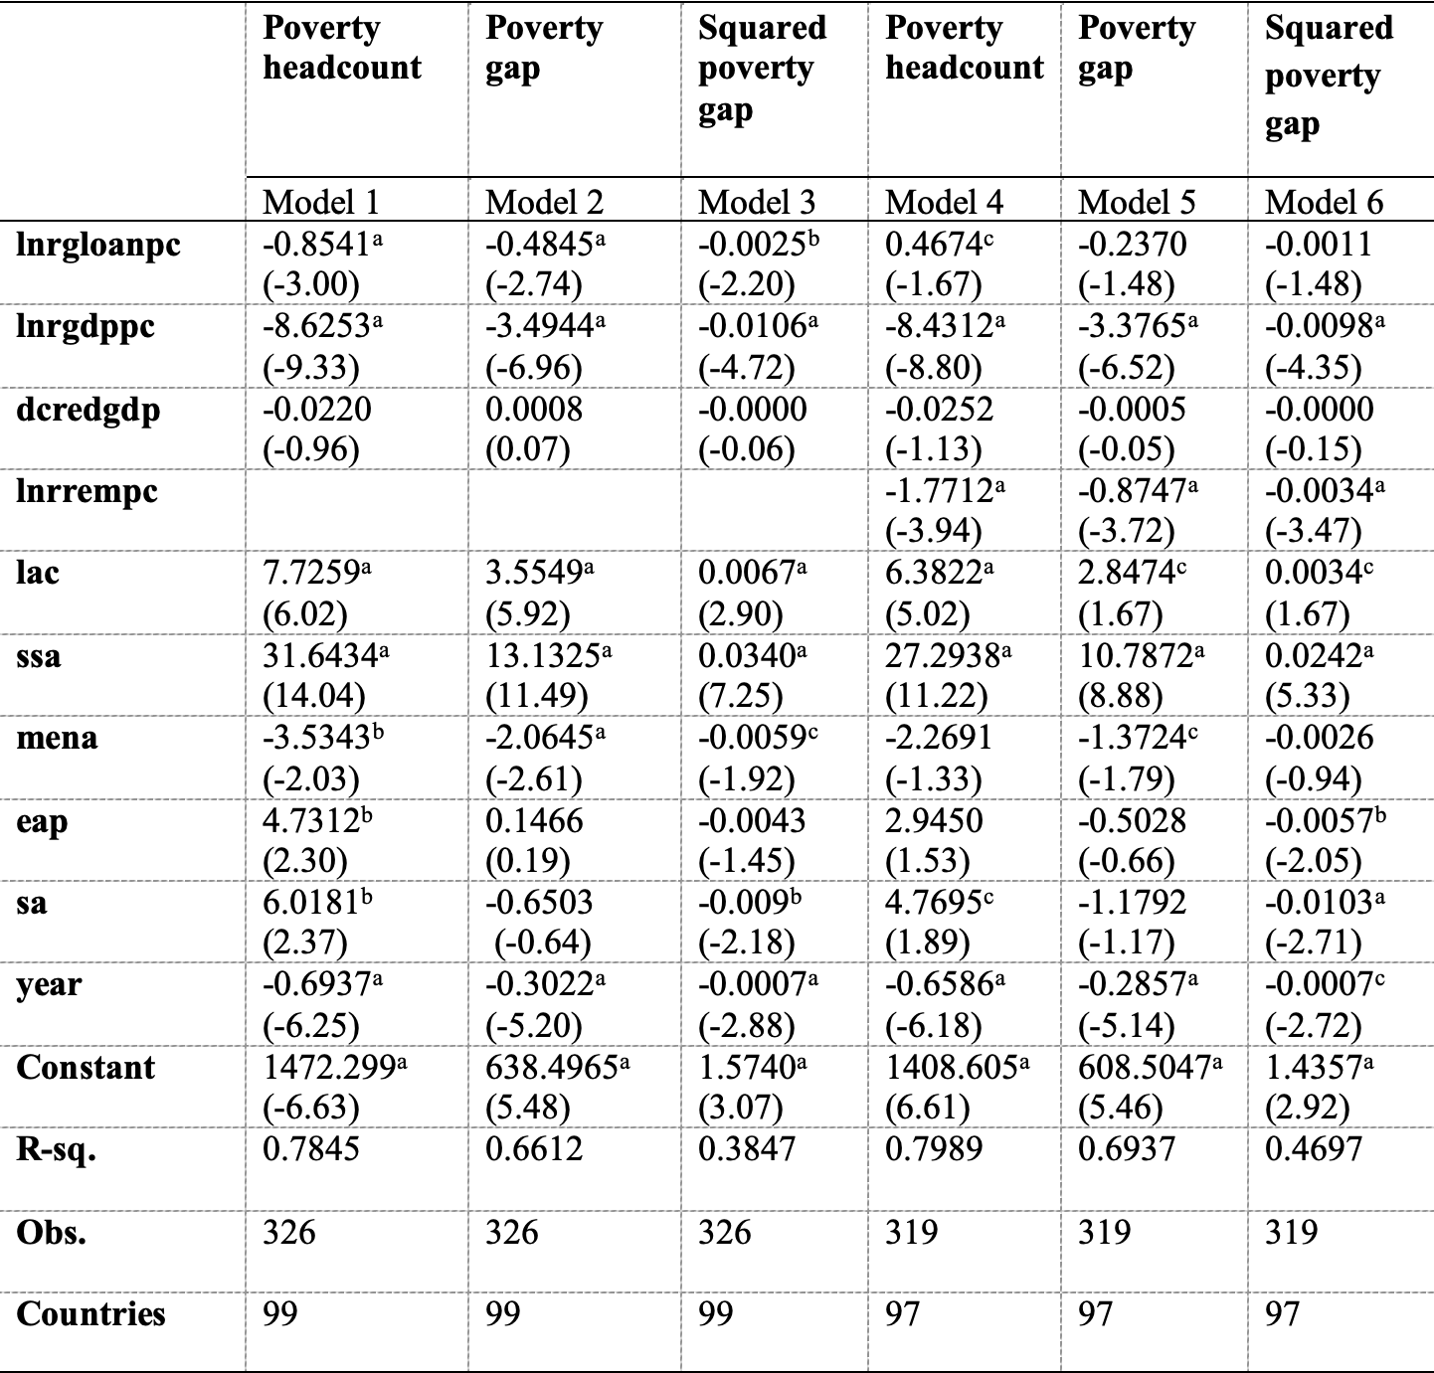
Result 1 : Effects of Remittances on Poverty, OLS 1990 -2020

Slide 11
Analysis: Result 1
Factors like gross loan portfolio per capita, GDP per capita, and remittances show significant impact on reducing poverty.
Gross loan portfolio per capita and remittances are endogenous variables, which could bias ordinary least squares (OLS) estimates.
To address the endogenous nature of remittance and gross loan portfolio , we used Panel Generalized Method of Moments (GMM) instrumental variable analysis.

Slide 12
Instruments
Gross loan Portfolio
Instrumented: lnrgloanpc
instruments: rlaw personnel1
Remittance
Instrumented: lnrrempc
instruments: lnrrempcl1 lnrrempcl2
Note: rlaw: rule of law; personnel1: expenses per assets (%)

Slide 13
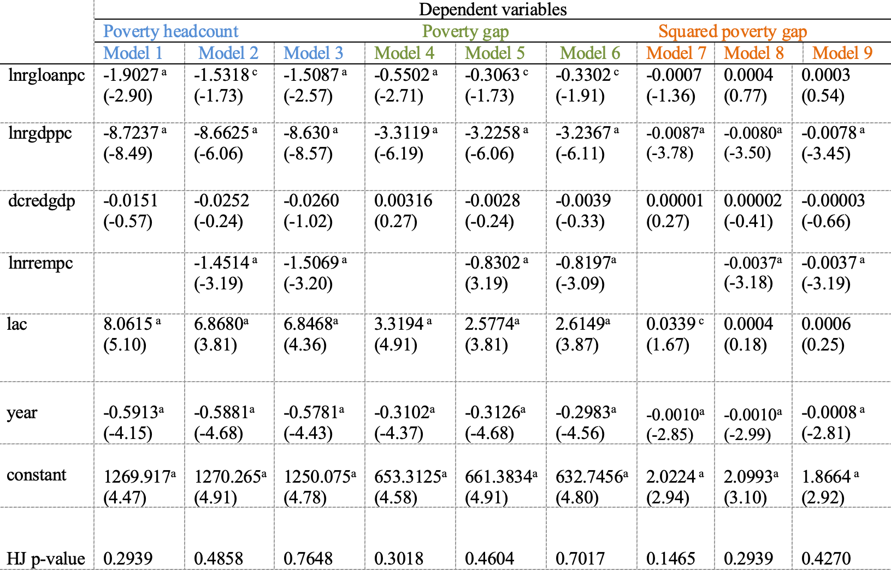
Result 2: Effects of Remittances on Poverty, PGMM 1990 -2020
Note: Developing regions are not included in slide for space but included in model.

Slide 14
Analysis: Result 2
Model 3, 6, and 9: These models control for the endogeneity of gross loan portfolio per capita by using Panel GMM instrumental variables.
Impact of Gross Loan Portfolio (GLP):
In Model 3: A 10% rise in GLP reduces poverty headcount by 0.15%.
In Model 6: A 10% rise in GLP reduces poverty gap by 0.3%.
In Model 9: GLP doesn't show a significant impact on poverty measures.

Slide 15
Analysis: Result 2
Impact of GDP per Capita:
In Model 3: A 10% rise in GDP per capita decreases poverty headcount by 0.86%.
In Model 6: A 10% rise in GDP per capita decreases poverty gap by 0.32%.
In Model 9: A 10% rise in GDP per capita has a minimal impact on poverty gap.
Impact of Remittances per Capita:
In Model 3: A 10% rise in remittances per capita decreases poverty headcount by 0.15%.
In Model 6: A 10% rise in remittances per capita decreases poverty gap by 0.81%.
In Model 9: Remittances have a negligible impact on poverty gap.
Instrument Validity: The Hansen p-value confirms that the instruments used in the analysis are valid.

Slide 16
Preliminary Conclusion
We conduct estimations of the effects of microfinance and remittances on poverty based on the models in Imai, K. S., Gaiha, R., Thapa, G., & Annim, S. K.,2012.
Microfinance and remittances reduce poverty in models 3 and 6.
Gross loan portfolio reduces poverty gap and poverty headcount but not squared poverty gap.
Remittance decreases poverty gap, poverty headcount and squared poverty gap.
The next step is to estimate the effect of remittances on poverty through microfinance given that Posso (2015) finds that microfinance promote remittances.

